Slide 1

NATIONAL CONFERENCE ON CONTEMPORARY ADVANCES IN INTERDISCIPLINARY SCIENCES (NCCAIS-2024)
4th – 6th April, 2024
Q&A LLM Chat Bot Using LangChain Framework
Presented By: Anuj Tiwari (M.Sc. Data Science & Analytics)
Supervised By: Dr. Surya Kant Pal
Department of Mathematics
Sharda School of Basic Sciences & Research
Sharda University, Greater Noida, Uttar Pradesh - 201310

Slide 2

Table of Contents
Introduction
Objective
Literature Survey
Methodology
Results & Discussions
Interpretation
Conclusions
References

Slide 3
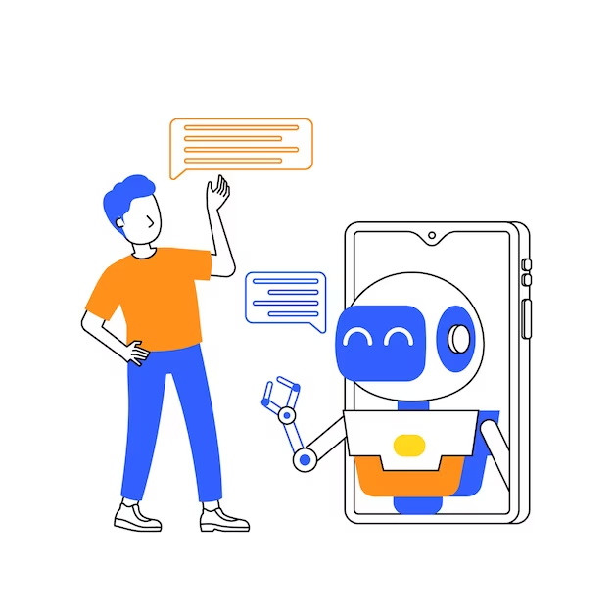
Introduction
The advent of advanced natural language processing (NLP) models has revolutionized the field of conversational agents, enabling the development of sophisticated chatbots capable of understanding and generating human-like responses. In this project, we propose the creation of Q&A LLM (Language Model) chatbot utilizing the LangChain framework. The chatbot will be powered by the GPT-3.5-turbo-instruct model, leveraging the API provided by OpenAI. Through the integration of the Streamlit library, the chatbot will be deployed, providing users with an interactive platform to seek answers on a wide range of topics. The primary objective of this project is to develop a conversational assistant that emulates human-like interaction, delivering accurate and relevant responses to user inquiries. By harnessing the capabilities of state-of-the-art NLP technology, this chatbot aims to enhance user experience and accessibility to information in diverse domains

Slide 4
Objectives
·Develop a Q&A Language Model (LLM) chatbot utilizing the LangChain framework.
Integrating the GPT-3.5-turbo-instruct model provided by OpenAI.
Implement the chatbot deployment using the Streamlit library to create a user-friendly interface for seamless interaction and enhanced accessibility.
Evaluate the performance of the chatbot in terms of response accuracy, relevance, and user satisfaction through rigorous testing and feedback analysis.
Iterate and refine the chatbot based on user feedback and performance metrics, striving for continuous improvement in functionality and user experience.

Slide 5
Literature Survey
Oguzhan Topsakal et al. (2023) The paper explores the utilization of Large Language Models (LLMs) for rapid application development, with a focus on LangChain, an open-source library. It discusses LLMs' diverse capabilities and LangChain's modular design, facilitating swift development of bespoke AI applications. Practical examples illustrate LangChain's potential in creating LLM-based applications efficiently. The study underscores LangChain's significance in advancing LLM application development methodologies.
Koh Matsuda et al. (2023) The study focuses on leveraging Large Language Model (LLM) applications in education, particularly through LangChain's integration capabilities. It introduces a system integrating Retrieval Augmented Generation (RAG) with external data from Pinecone database, aiming to enhance educational interactions. The paper discusses methods for LangChain integration in education, highlighting benefits and potential challenges. Future improvements target refinement based on user feedback, utilizing LangSmith.
Arjun Pesaru (2023) This paper showcases the integration of LangChain and the Large Language Model (LLM) to develop a PDF chatbot. LangChain simplifies chatbot creation and scalable AI/LLM applications, while LLM offers diverse text generation capabilities. The chatbot, trained on a PDF dataset, leverages LLM for text responses and Google Search for broader information access. Utilizing Pinecone for storage and React JS for frontend, the project demonstrates LangChain and LLM's potential in creating informative, versatile chatbots.
Lianmin Zheng (2023) This paper examines the challenge of evaluating large language model (LLM) based chat assistants, proposing the use of strong LLMs as judges. It investigates biases and limitations in LLM judgment, suggesting methods to address them. Two benchmarks, MT-bench and Chatbot Arena, are introduced to verify LLM judgment against human preferences. Results indicate strong agreement between LLM judges and humans, highlighting the scalability and cost-effectiveness of LLM-based evaluation methods
Mahyar Abbasian et al. (2024) This paper addresses the limitations of current Conversational Health Agents (CHAs), particularly their lack of multi-step problem-solving and personalized interactions. It introduces openCHA, an open-source framework powered by Large Language Models (LLMs), designed to enhance CHAs' capabilities. openCHA enables integration with external sources for data analysis and knowledge acquisition, fostering personalized, multi-modal conversations in healthcare settings. The framework's proficiency in handling complex healthcare tasks is demonstrated through three illustrative examples.

Slide 6
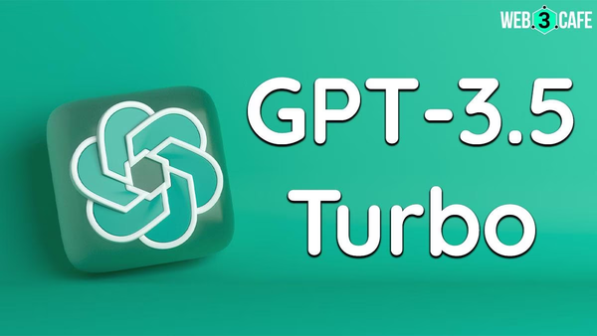


Methodology
01
02
03
04
Study About the GPT 3.5 Turbo
Apply gpt-3.5 turbo instruct model
Code on Visual Studio
Deployment it on Streamlit

Slide 7
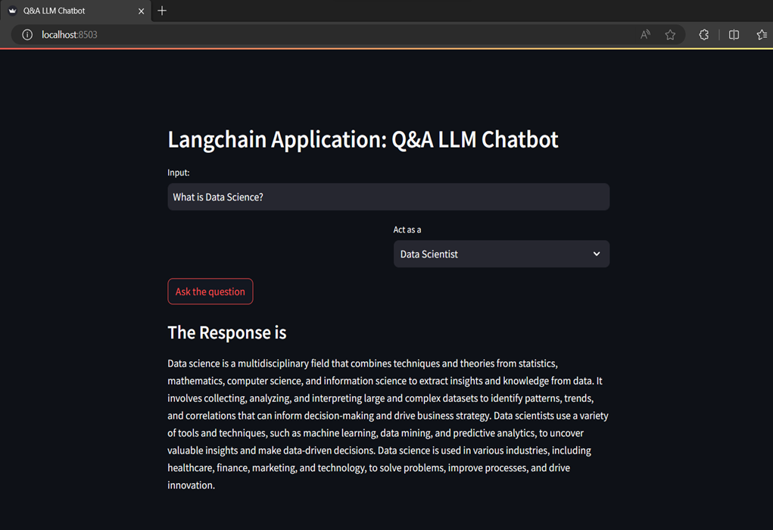
Results & Discussions
After Successfully writing
our code we will now run
our application. Shown
the interface of our
application:

Slide 8
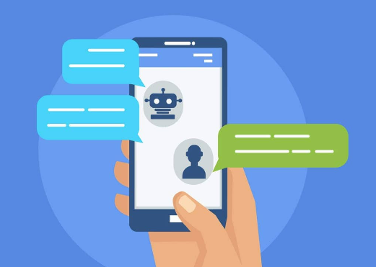
Conclusion
Embracing Challenges, Building Solutions Together
We succesfully built and deployed a Q&A chatbot utilizing LangChain and GPT-3.5-turbo-instruct, accessed via OpenAI's API and deployed in a user-friendly interface. It explored the potential of this combination to create a personal assistant-like chatbot for answering diverse questions across various domains. The project successfully demonstrated the effectiveness of LangChain in retrieving relevant information for the chatbot and the GPT-3.5-turbo-instruct model's ability to understand user queries and generate informative responses. This contributes to the advancement of Q&A chatbot development by showcasing the potential of these technologies in a practical application. Future work could involve data analysis tools like LangSmith to refine the chatbot based on user interaction patterns and explore incorporating domain-specific models for even more specialized applications. Overall, this project successfully explored the potential of LangChain and GPT-3.5-turbo-instruct for building a versatile Q&A chatbot, paving the way for further advancements in the field.

Slide 9
References
[1] Matsuda, K. and Frank, I., 2024. LangChain Unleashed: Advancing Education Beyond ChatGPT’s Limits. arXiv preprint arXiv:2410.02474.
[2] Abbasian, M., Azimi, I., Rahmani, A.M. and Jain, R., 2024. Conversational health agents: A personalized llm-powered agent framework. arXiv preprint arXiv:2410.02474.
[3] Zheng, L., Chiang, W.L., Sheng, Y., Zhuang, S., Wu, Z., Zhuang, Y., Lin, Z., Li, Z., Li, D., Xing, E. and Zhang, H., 2023. Judging llm-as-a-judge with mt-bench and chatbot arena. Advances in Neural Information Processing Systems, 36. arXiv preprint arXiv:2306.05685v4.
[4] Topsakal, O. and Akinci, T.C., 2023. Creating large language model applications utilizing langchain: A primer on developing llm apps fast. In International Conference on Applied Engineering and Natural Sciences. arXiv preprint arXiv:2308.04472.
[5] Abbasian, M., Azimi, I., Rahmani, A.M. and Jain, R., 2023. Conversational health agents: A personalized llm-powered agent framework. arXiv preprint arXiv:2310.02374.

Slide 10

Thank you
Let's Keep the Conversation Flowing!

Slide 11
NATIONAL CONFERENCE ON CONTEMPORARY ADVANCES IN INTERDISCIPLINARY SCIENCES (NCCAIS-2024)
4th – 6th April, 2024
Q&A LLM Chat Bot Using LangChain Framework
Presented By: Anuj Tiwari (M.Sc. Data Science & Analytics)
Supervised By: Dr. Surya Kant Pal
Department of Mathematics
Sharda School of Basic Sciences & Research
Sharda University, Greater Noida, Uttar Pradesh - 201310

